Slide 1
Profiling

Slide 2

Notes:
Games are, generally, high performance real-time systems, as such, game engine programmers are nearly always looking for ways to speed up their code. There’s something called the Pareto principle, which says that 20% of the input accounts for 80% of the output, software engineering takes this a bit further with the 90/10 rule that states that 90% of the running time of a program is accounted for by only 10% of the code. So if we optimise 10% of the code, you can potentially gain 90% of all the gains in execution speed you’ll ever realise. The problem comes down with identifying where that 10% of code actually is – which is where profiling comes in.

Slide 3
Notes:
Profiling is the act of improving the execution speed of your program and removing any bottlenecks from the code. We can do this by measuring how long parts of your code take to execute and rewriting slow algorithms to be more efficient. These take the form of bottlenecks, where a frame takes a particularly long time to process, causing a noticeable hitch in performance – they can be caused by all sorts of things, but typically if you’re waiting on something to complete (a hard drive read) or you’re just trying to do too much in one frame – we may be making just a few calls to our A* implementation in a frame, but each call may take a while to complete or equally, we may have something as “cheap” as a dot product function, but we’re calling it hundreds of thousands of times a frame – either of these could create bottlenecks.

Slide 4

Notes:
Profilers can provide us with a wealth of information about our code, some report the call graph for a function, allowing us to see what functions called that function (parent functions) and which functions it called (its child functions). This means we can see the percentage of a functions running time that was spent calling its child functions and the percentage of the overall running time accounted for by each individual function.
There are two main types of profilers: statistical; designed to be unobtrusive, so the performance of code being profiled is impacted only minimally. They work by sampling the CPUs program counter register and noting which function is currently running. The number of samples taken in each function gives us an approximate percentage of the total running time taken up by the function. Really good profilers don’t come cheap, with the “best” of the lot being Intels Vtune, which will set you back $900 outside of the trial period. There are open source alternatives such as Luke Stackwalker however.

Slide 5

Notes:
The other type are instrumenting profilers; these impact performance of running code but give the most accurate and comprehensive timing data possible. They work by inserting special code at the start and end of your functions, this code calls into the profiling library, which inspects the call stack at that moment in time and stores a plethora of information. These sorts of profilers can even run on a line by line basis, but that definitely brings things to a crawl.
There are also hybrid profilers, that sort of combine both styles – statistically sampling the state of the processor, which reduces their impact on the performance – but for each sample they analyse the call stack, determining the chain of parent functions that resulted in each sample.
Of course, this only works if we have access to a profiler suite that works on our target platform (common on windows, less so on linux and even rarer on consoles).

Slide 6

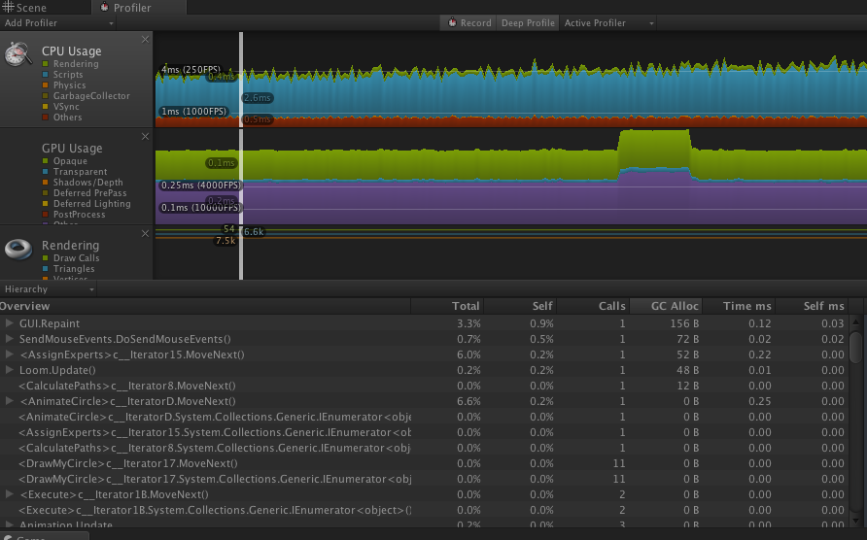
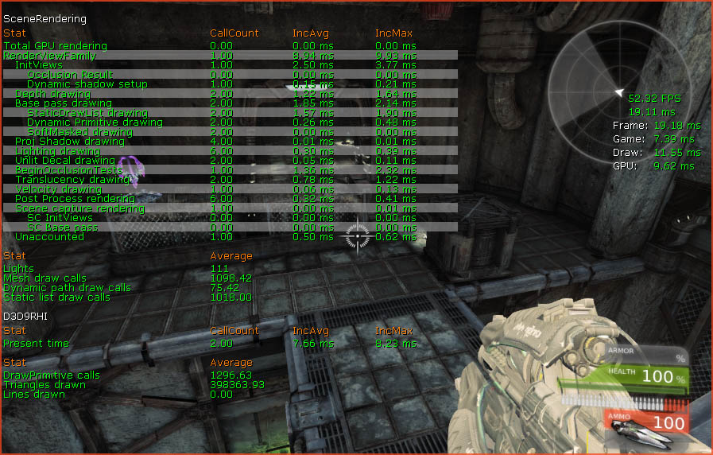
Notes:
Even if we have access to those sorts of tools, it’s pretty handy if our engine can also provide us with some form of profiling information, it’s often easier to see the context of the profiler results in-game while the engine runs than trying to peer through the results of a profiler run to find a troublesome spot. Typically, these are implemented in a way that allows an engineer to annotate blocks of code (not just entire functions!) that should be timed and give them human-readable names. The profiler uses the CPU’s hi-resolution timer and stores the results in memory – the results can either be dumped out into a file or, even better, displayed on-screen during run time.
Such a display should show up-to-date execution times for each tracked code block, this data can be displayed in various forms; raw number of cycles, execution times and percentages relative to the execution time of the entire frame are common.

Slide 7

struct Profile
{
Profile(const char *name)
{
_name = name;
LARGE_INTEGER li;
QueryPerformanceCounter(&li);
startTime = li.QuadPart;
}
~Profile()
{
LARGE_INTEGER li;
QueryPerformanceCounter(&li);
__int64 endTime = li.QuadPart;
__int64 elapsedTime = endTime - startTime;
g_profileManager.storeSample(_name, elapsedTime);
}
const char *_name;
__int64 startTime;
};
#define PROFILE(name) Profile p(name)
typedef std::map<const char*, std::vector<SampleData*>> FrameMap;
class ProfilerSystem
{
public:
ProfilerSystem();
~ProfilerSystem();
void startFrame();
void storeSample(const char *name, __int64 elapsedTime);
void endFrame();
private:
int currentFrame;
FrameMap frameData;
};
extern ProfilerSystem g_profileManager;
struct SampleData
{
__int64 functionTime;
int frameReference;
};
Grab the counter value when we construct the profile object
The typedef here makes the class declaration cleaner
{
PROFILE(“System Update");
system->update();
}
Find the elapsed time when it is destroyed
void ProfilerSystem::storeSample(const char *name, __int64 elapsedTime)
{
SampleData *sample = new SampleData();
sample->frameReference = currentFrame;
sample->functionTime = elapsedTime;
frameData[name].push_back(sample);
}
{
Profile p("System Update");
system->update();
}
The vector in the map lets us store multiple frames worth of data.
We declare an extern variable to give us global access to an instance
This define gives us a macro to instantiate an instance of profile.
Notes:
So, to actually implement this, we need to come up with a couple of systems:
ProfilerSystem: stores samples that are tagged with meta data (function name, elapsed time, function call count etc), this should be a globally accessible class and can also provide us with the option of dumping all of our sample data out to a csv or similar file so we can open them in excel and produce lovely graphs!
Profile: measures the time elapsed between its construction and its deconstruction – so we’re making use of the nature of scope in C++ to make this thing work how we need. (it is destroyed when we hit the closing brackets)

Slide 8

Notes:
We could also provide our profiling system with the ability to track the engines memory usage, as that’s one of the other major constraints on our system outside of frame rate. While engines aimed at PCs have slightly less to be concerned by here, as modern PC systems have pretty fancy memory mangers, but we should still account for minimum specs by ensuring that our game can actually run on a machine at that level. So memory tracking allows us to see how much memory is being used by each sub-system and whether or not there are any leaks (allocated memory that is never freed).
However, this is quite a complicated job – in an ideal world, we would just wrap new / delete with some code that tracks the size of the objects being allocated and destroyed. However, that is not as straight forward as we might want it to be, for a few reasons:

Slide 9
Third Party Libraries
Video RAM usage
Memory Management
Notes:
Odds are high that we’re working with someone else code from a third party library and it’s difficult to control the allocation behaviour of code that is not our own – we may be able to replace their allocators with custom versions, but that’s not guaranteed.
Tracking video ram usage is particularly troublesome – modern graphics APIs are designed to hide this from us so they can be as efficient as possible.
Sensible memory management (which we will get around to talking about before too long) requires us to pre-allocate a lot of memory and use that space for any further allocations we need, but this means we’d only see a handful of allocations when the engine starts and none of the actual run time memory usage would be tracked.

Slide 10
Accurate Information
Data Presentation
Providing Context
Notes:
Building an efficient and useful memory tracking tool is a significant task, but it can do a lot to help us understand what’s going on in terms of our memory usage – so we can tell if we’re using more than our minimum spec allows for (or, on console, more than a retail unit has available). Which lets us reign in designers who may have built a level that just won’t work on our target platform.
The keys for good memory analysis are: providing accurate information, presenting the data in convenient way that makes problems obvious and providing context to aid in tracking down the root cause of problems when they occur.

